Slide 1
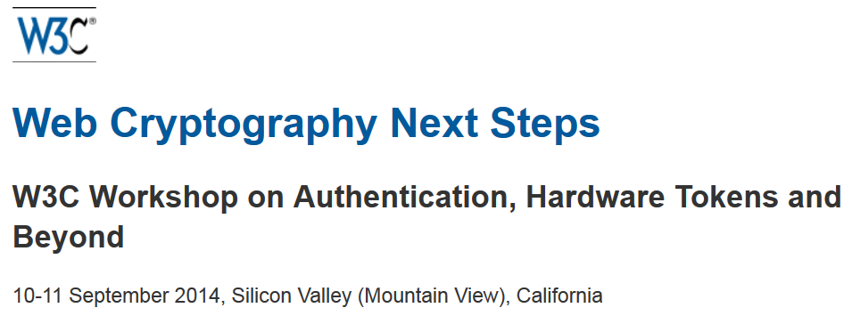
Authentication Session
Hannes Tschofenig

Slide 2
Introduction
Problem with passwords has been known for a long time.
Many attempts have been made to invent and standardize solutions for multi-factor authentication, strong password-based solutions.
  There is no shortage of solutions.
These efforts have been successful only to a certain extend.
  Getting widespread deployment for any single mechanism has failed.
IMHO these failures are not been due to technology but due to misaligned incentives and competing business models.
Picked FIDO as an example technology.

Slide 3
FIDO Overview
Browser/App
Relying Party
FIDO over
HTTP/JavaScript
Client
example.com
FIDO over
USB/BLE
Assumption:
  The Authenticator and the Relying Party have no keying material established.
  Relying party and browser have no
  out-of-band relationship
  (which is typical on the Web).
Authenticator
Procedure:
  User goes to relying party website, such as example.com.
  TLS server-side authentication: certificate has to match user-entered URI
  Authenticator dynamically generates public / private key pair (PK_{example.com} & SK_{example.com})
  Authenticator registers public key PK_{example.com} with example.com
  Authenticator uses PK_{example.com} (and SK_{example.com}) with example.com

Slide 4
FIDO Extension for Web Crypto API
Main goal of many JavaScript APIs is to find building blocks rather than standardizing point solutions.
  Building blocks then used to craft solutions.
What is needed for FIDO?
  Discovery of available hardware authenticators and their capabilities.
  Privacy support so that
    the same PK/SK pair is not used across relying parties, and
    the user provides consent.
  Relaying of the FIDO-specific public key crypto protocol to a selected Authenticator.
Can we identify “abstract” functions that can then be used to build FIDO and all other authentication protocols?

Slide 5
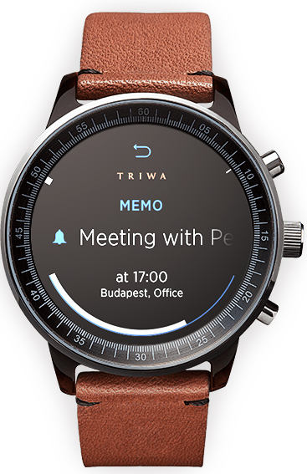
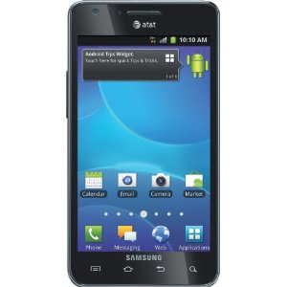

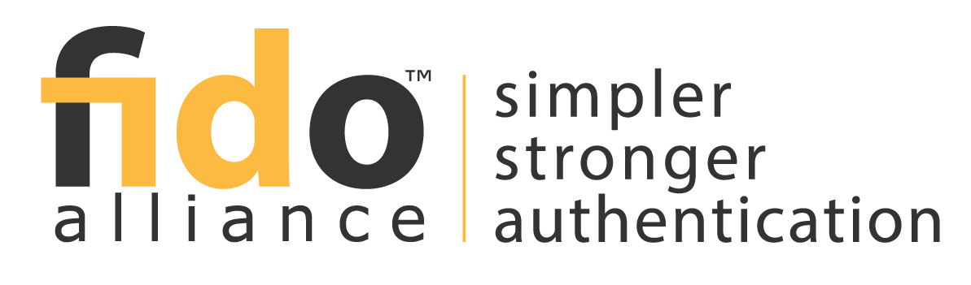


Many Stakeholders Need to Cooperate
Identity Providers
OpenID
Connect
SAML
USB,
wireless (BLE, etc.),
local API
Authenticator

Slide 6
My Questions to this Group
Is it possible to reflect on the mistakes made in the past to avoid repeating them?
How can be work with the wide range of stakeholders to reach a widespread deployment?
  Or: Can we design around some barriers?
Is there an abstract API that allows innovation by many different players?
  Read “innovation” as “I want to do whatever I want”.
How do we collect experience with the end-to-end solutions?
How much to worry about limitations of deployed technology?
(Almost) everyone wants to have privacy but what are the properties would we like to offer? (see RFC 6973)

